Slide 1

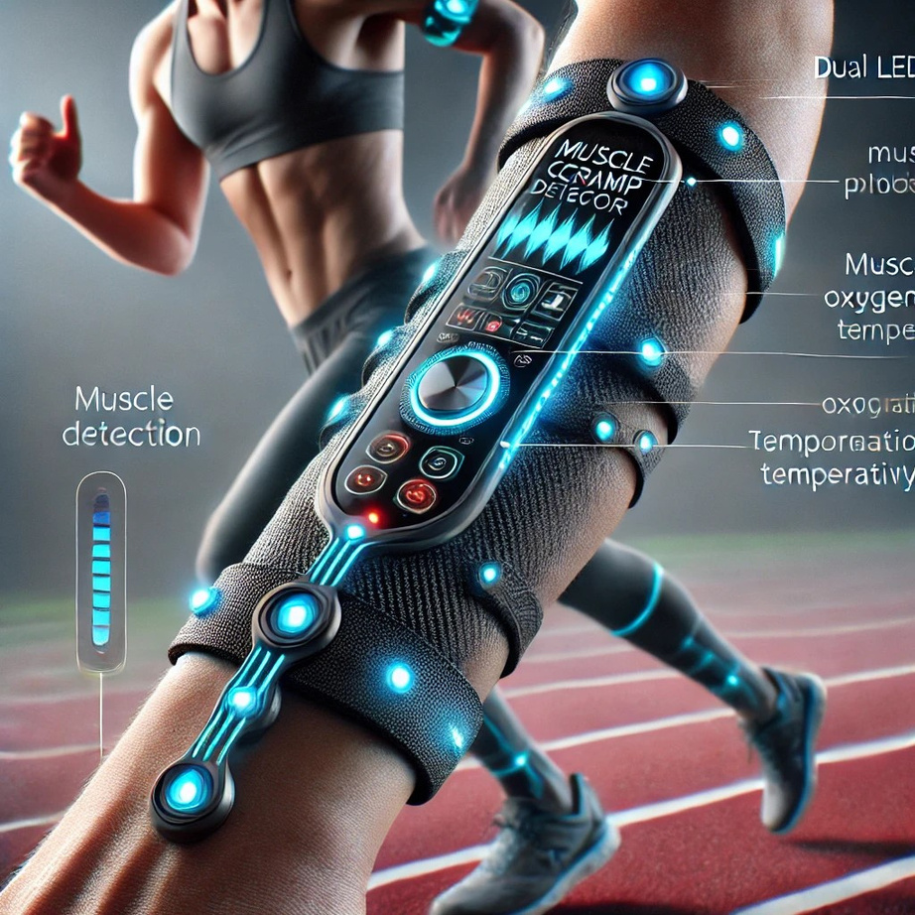
MUSCLE CRAMP DETECTIOR
T.Dayananthan
A.Prathishanth
A.Thamilezai

Slide 2
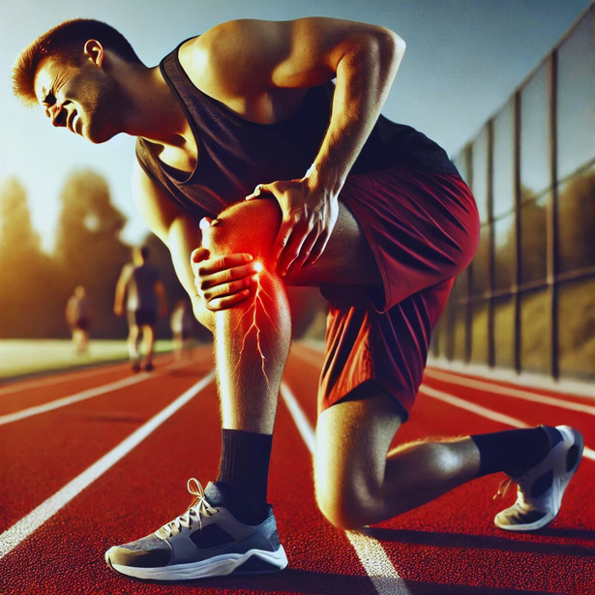
Introduction
Muscle cramps are sudden, involuntary muscle contractions that
disrupt performance and increase the risk of injury.
Muscle cramps are a severe issue for athletes, and our device provides an effective solution by enabling early detection and timely intervention.

Slide 3
PRODUCT OVERVIEW
Our product utilizes muscle oxygen concentration sensors, temperature sensors, EMG sensors to analyze and accurately detect muscle cramps.
We implemented Wi-Fi data transmission and MATLAB analysis using the ThingSpeak IoT platform for data exchange and efficient analysis of data within MATLAB, ensuring accurate and reliable performance.

Slide 4
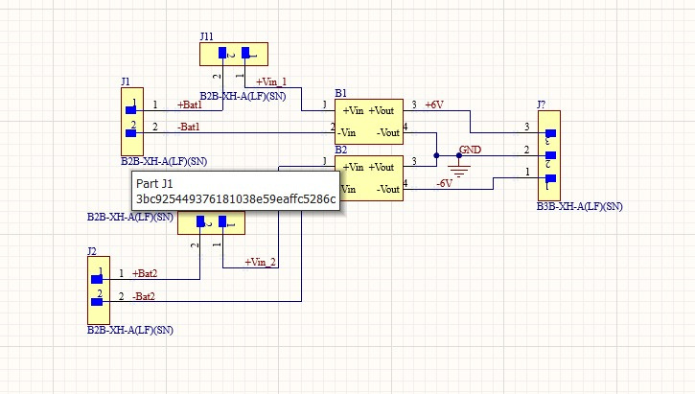
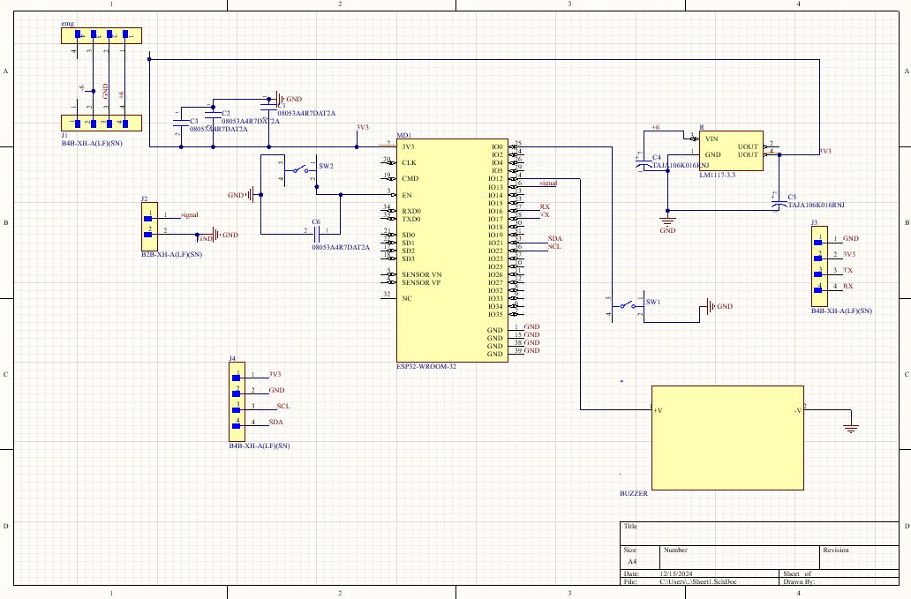
Design and Development
Schematics
Power supply
Main schematic

Slide 5
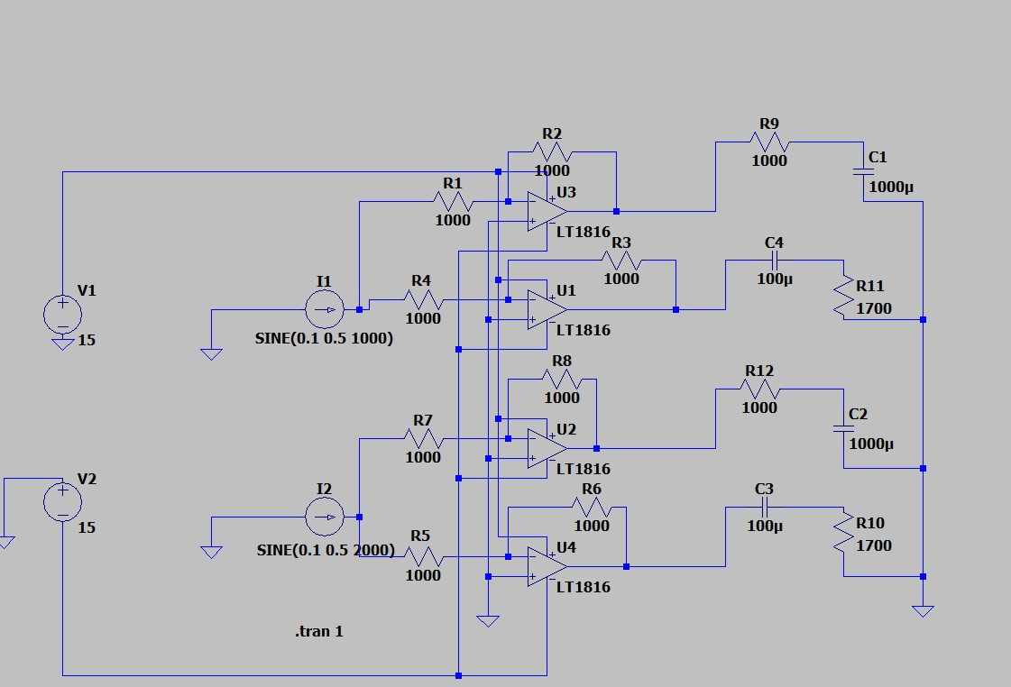
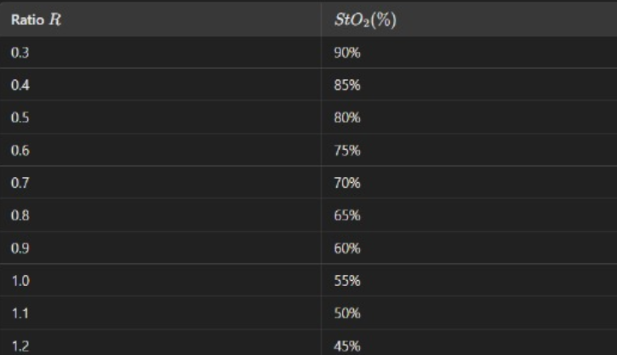
oxygen saturation of muscle finding circuit
lookup table of sto2

Slide 6
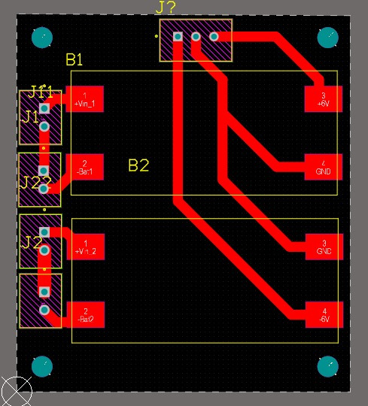
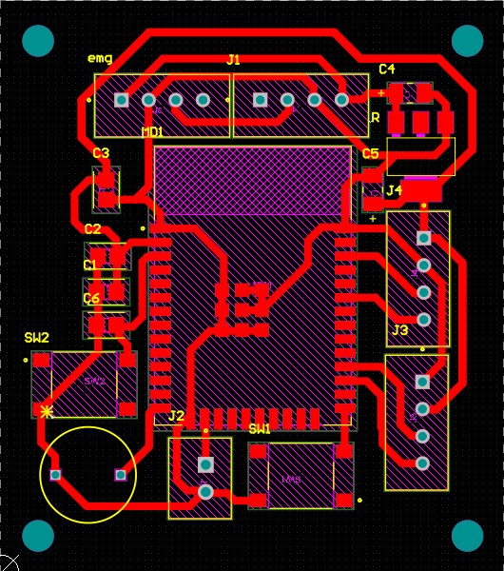
Design and Development
PCB
Power supply
Main PCB

Slide 7
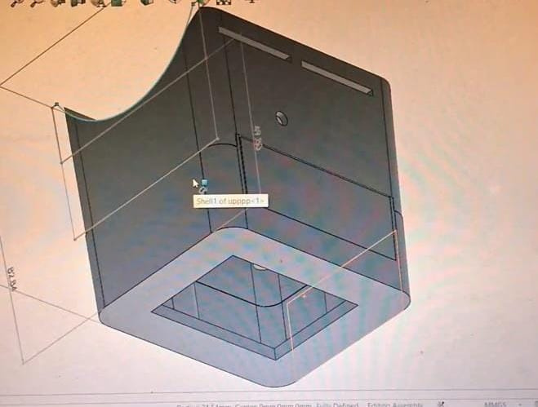
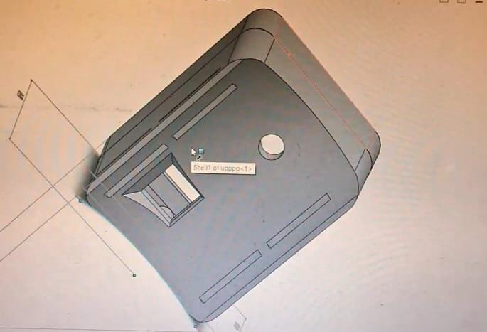
Design and Development
Enclosure

Slide 8
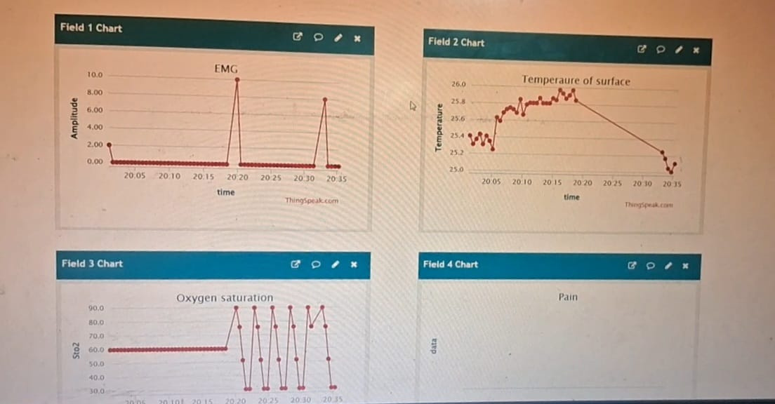
Design and Development
Thingspeak Matlab Analysis
Data from sensors is received by ESP32, transmitted via Wi-Fi to ThingSpeak for real-time visualization, and analyzed using MATLAB on the platform.

Slide 9
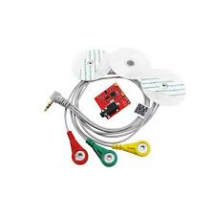
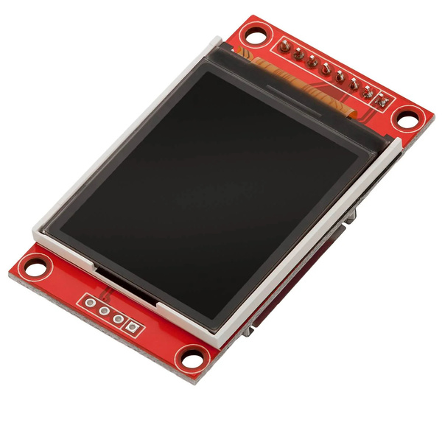
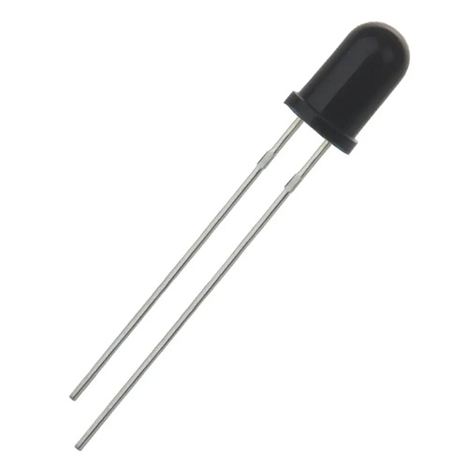
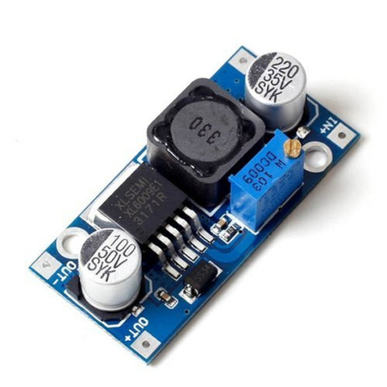
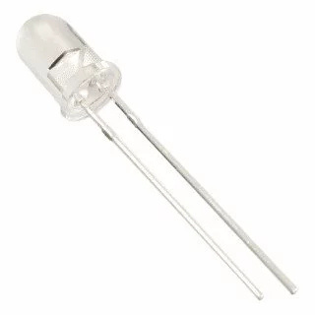
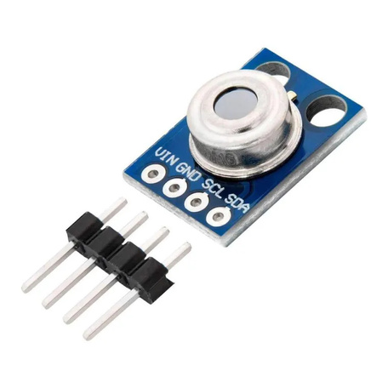
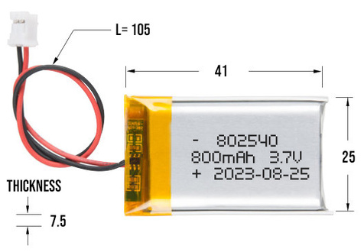
Technical Details

Slide 10
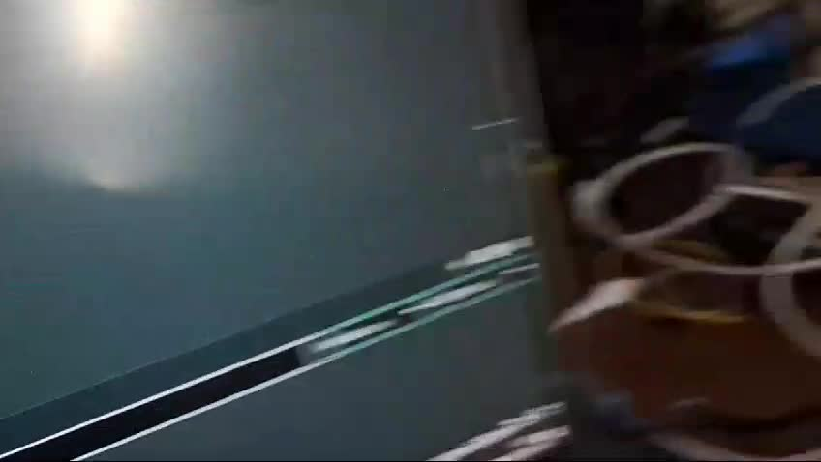
Demonstration

Slide 11
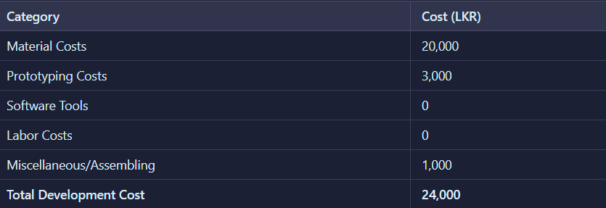
Cost Analysis

Slide 12
Limitations and Future Enhancements
1.Limitations
IoT Delays: Wi-Fi/network latency affects real-time monitoring.
Limited Features: Core detection only; lacks advanced analysis.
Sensor Limitations: Limited accuracy and adaptability.
Setup Complexity: Requires basic technical knowledge.
2.Future Enhancements
Better Signal Processing: MATLAB integration and advanced filtering.
Reduced Delays: Use low-latency protocols like MQTT or edge computing.
More Features: Add sensors (e.g., accelerometers, NIRS) and predictive analytics.
User-Friendly Interface: Intuitive mobile app and guided setup.
Scalability: Support for multiple users or team monitoring.

Slide 13
Conclusion
Achievements
Developed an affordable, portable muscle cramp detector with a buzzer and display.
Demonstrated its use in prosthetics, sports, and rehabilitation.
Showcased applications in performance analysis and assistive technology.
Impact
Provides an affordable alternative to expensive muscle cramp detectors.
Benefits patients, athletes, and researchers by improving muscle monitoring.
Enhances local accessibility in Sri Lanka, supporting underserved communities.
Future Outlook
Introduce wireless features and AI integration for smarter analysis.
Implement real-time message alerts to trainees' mobile devices for instant updates on muscle cramp risks.
Utilize IoT integration for seamless communication between the device and mobile apps.
Focus on enhanced data visualization for user insights.
Enable personalized notifications with actionable insights to improve performance and recovery.
Explore partnerships in healthcare, sports, and prosthetics innovation.

Slide 14
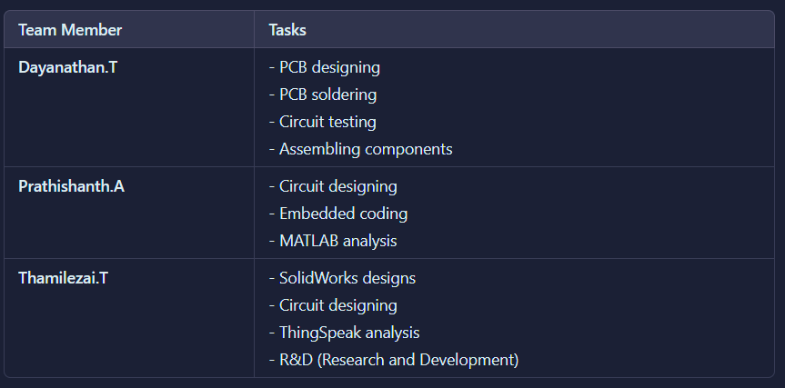
Our Team and Task allocation

Slide 15
Thankyou

